Slide 1



An Integrated Internet of Things Monitoring System Joint work with TAMK University
Dmitry Chudnovsky & Or Benyamin
Supervised By Dr. Naomi Unkelos Shpigel
23.9.24
24-2-D-11
Notes:
Hello everyone, me name is Or this is Dima and today we will present to you the phase A of our project:
"An Integrated Internet of Things Monitoring System – Joint work with TAMK University"

Slide 2
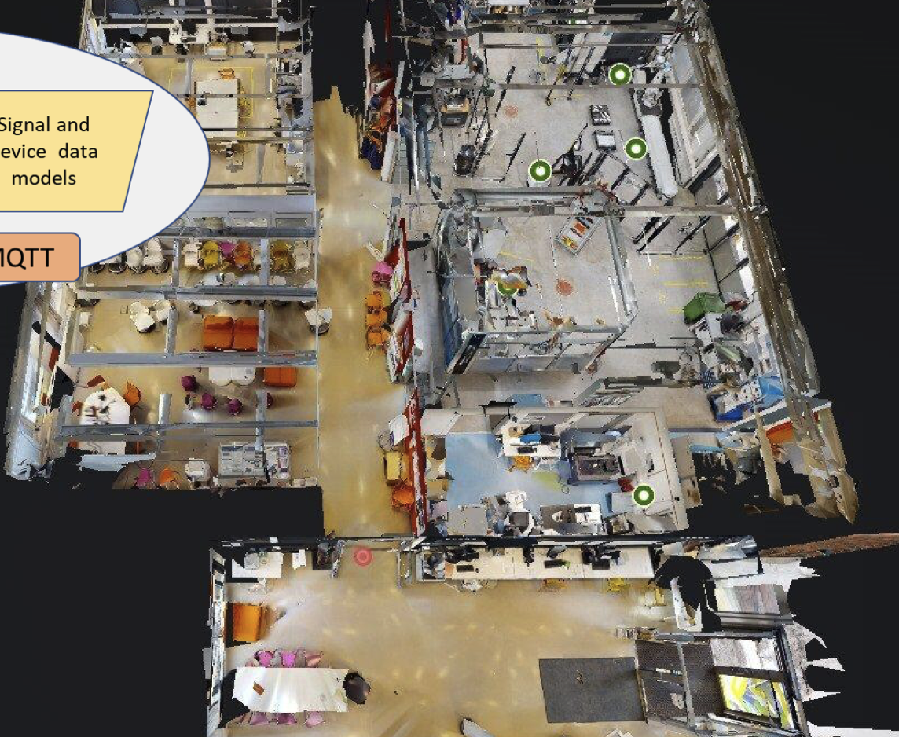
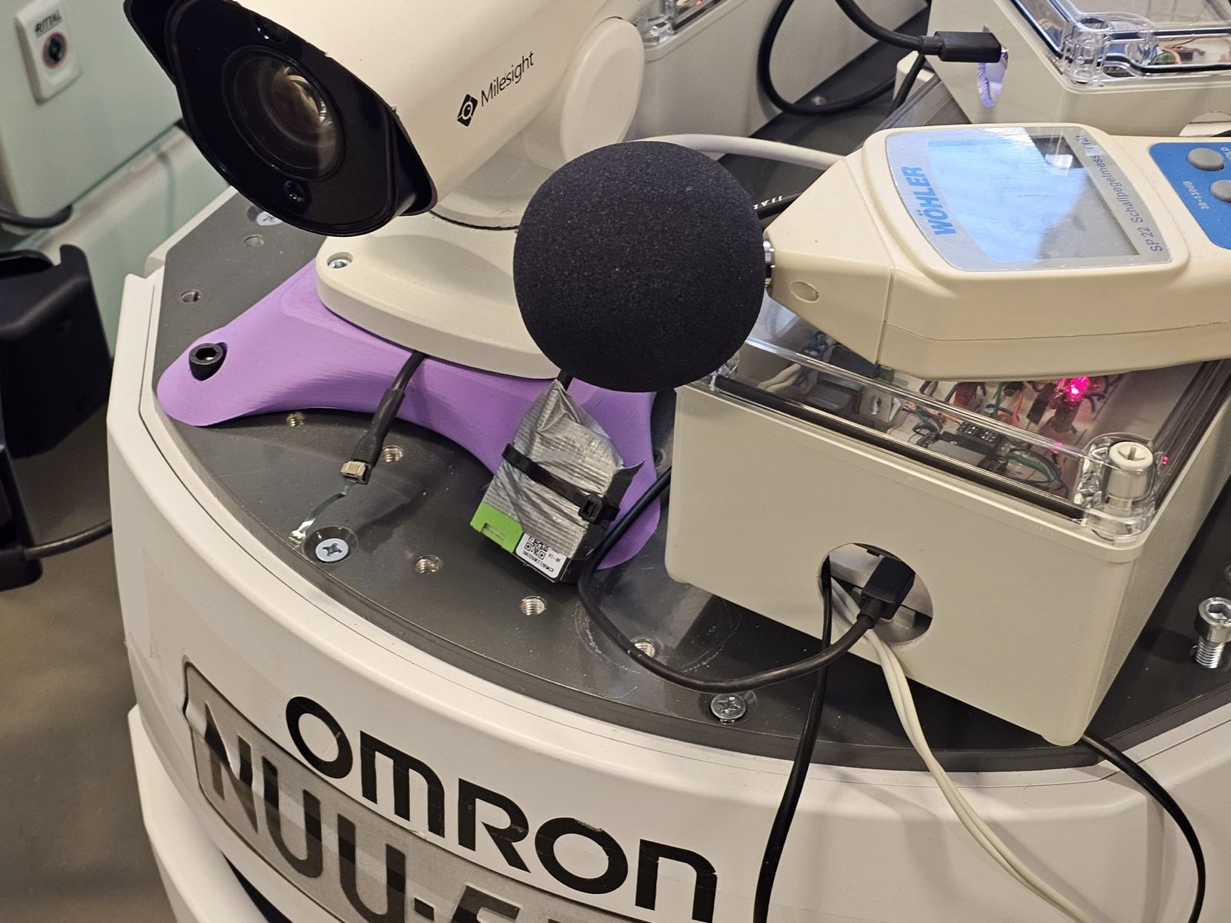


Overview
Tampere University of Applied Sciences (TAMK) is one of Finland’s largest universities of applied sciences.
Known for its expertise in technology, business, health case and media.
Problem: Absence of comprehensive system to effectively monitor and transmit live data from robotic units.
TAMPERE
University of Applied Sciences
Notes:
So let's talk about TAMK university.
TAMK, Tampere University of Applied Sciences is one of Finland's largest universities of applied sciences.
It known for its expertise in technology, business, health-care and media.
In the picture you can see a layout of the laboratory where the devices and robotics are located. In the small picture you can see an example of robot with sensor and camera on it.
The main challenge of the laboratory lies in the absence of comprehensive system to effectively monitor and transmit live data from robotic units.

Slide 3
Work Process
First Meeting advisor
Understanding Project Requirements
Searching relevant literature
Prototype display
First Meeting | 17.6.24
Work on first Project Prototype
Initial skeleton structure
Initial Project instructions
Google Scholar
Second Meeting | 27.6.24
Advanced Prototype
UML Diagrams
Use Case & Activity
Third Meeting | 5.8.24
Project Book progress
Project Testing
Deciding on project testing
Finishing Book
Final steps for completing the project's book
Fourth Meeting | 11.9.24
Displaying final book
Website progress discussion
TAMPERE
University of Applied Sciences
Notes:
How was our work process this phase.
First we had a meeting with our advisor that provided us with the information, requirements and needs of the project.
After that we started working on the literature review and searched for relevant literature that connects to our project.
This semester we worked according to the Agile methodology. We had four meetings with the customer when we showed him the process, got feedback from him and continued to work. The next three stages are working on skeleton project, having first meeting and getting feedback and second meeting showing the advanced prototype, with the changes made according to the comments from first meeting.
After that, we started to work on the Use Case and Activity diagrams followed by third meeting with the customer showing him the book project.
The next two stages are about testing parts and finishing the book project.
In the last step, we had the fourth meeting showing the book and discussing about the website progress.

Slide 4

User Centered Design​
User requirements
Understanding the needs and the challenges of our customer.
User feedback
Getting customer's feedback during the schedule meetings.
User involvement
Having contact with the customer also using e-mail.
Iteration
Making changes and improvements after deep understanding the customer.
TAMPERE
University of Applied Sciences
Notes:
Our work is User Centered Design.
Our work was about focusing on customer's requirements and working with him closely, which means involving him in all the development process.

Slide 5
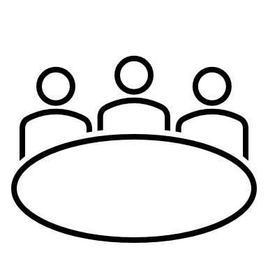
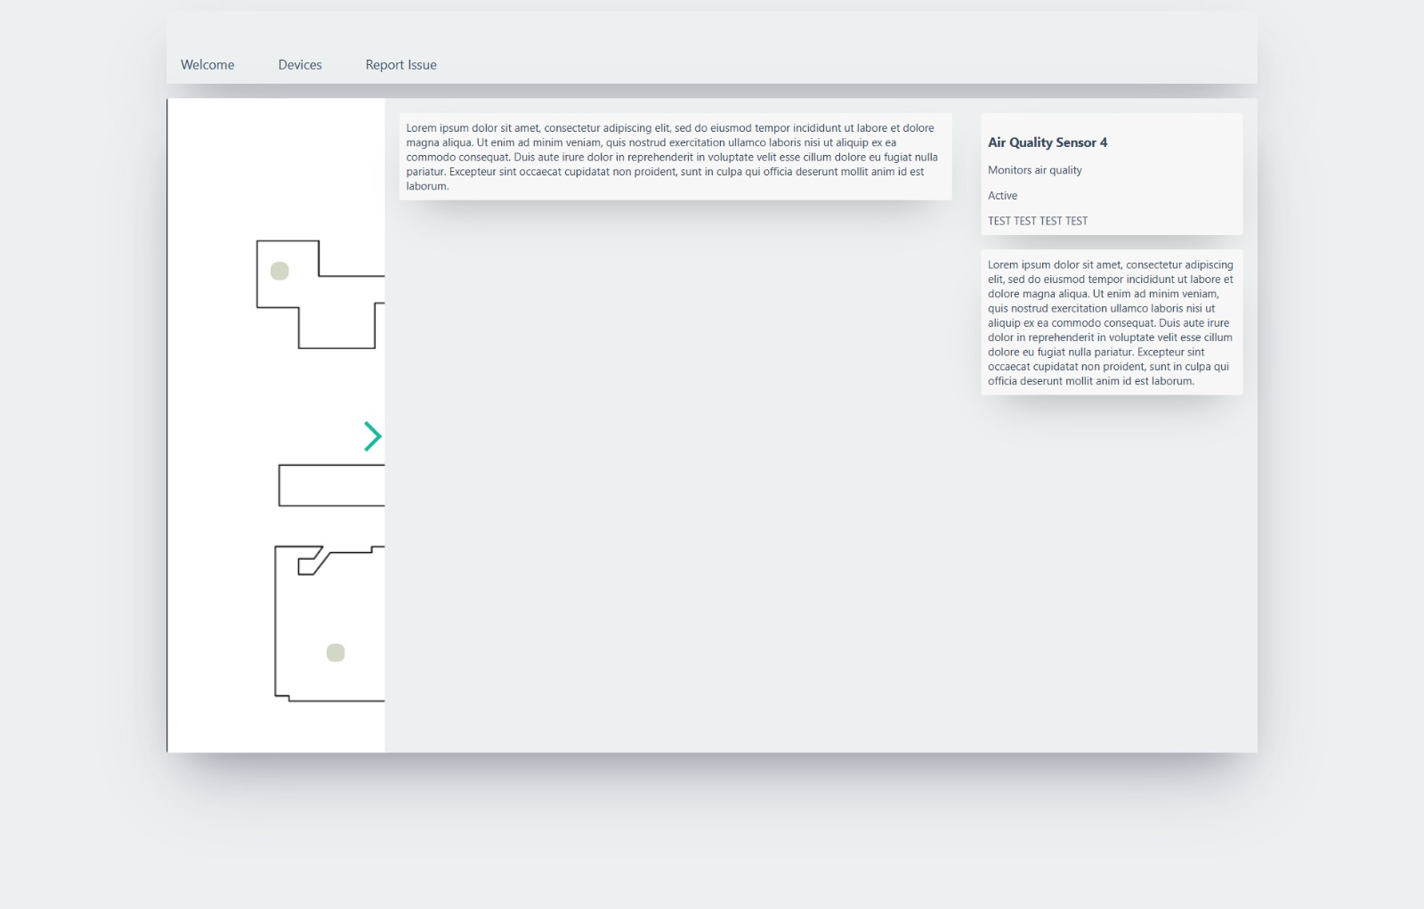
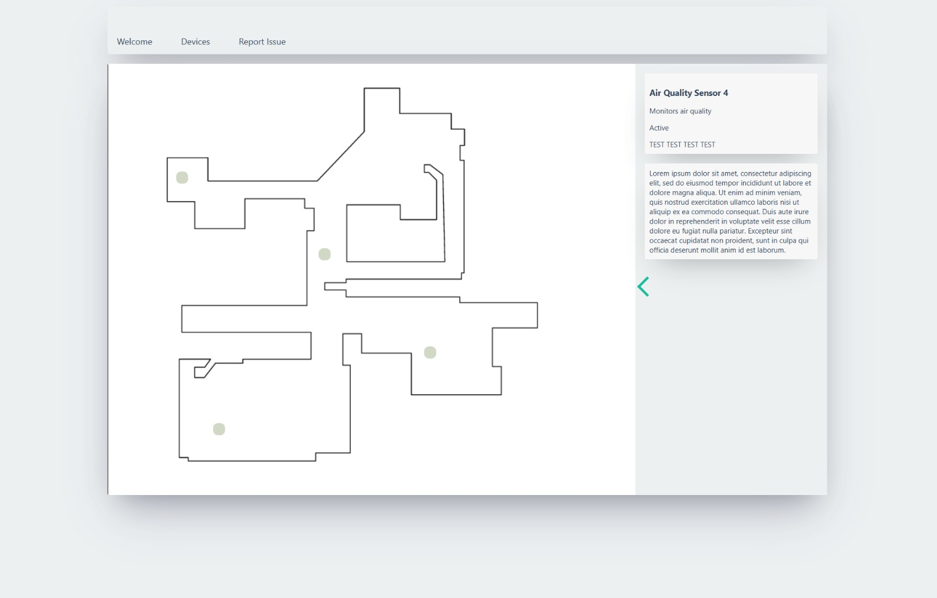
Summary of Meetings
First Meeting
First look of the project.
Agreeing on one API which gathers all data.
Second Meeting
Displaying project prototype.
Website live updates.
3D model discussion.
TAMPERE
University of Applied Sciences
Notes:
A little bit of summary of the meetings.
The first meeting was about first look on the project and agreeing on one API which gather all data. Before we had for each device data it's own API.
The second meeting was about implementing the comments from first meeting, showing the website with live updates and discussing about the need of three D model.
In the two pictures you can see and example of the look of the website in the beginning.

Slide 6
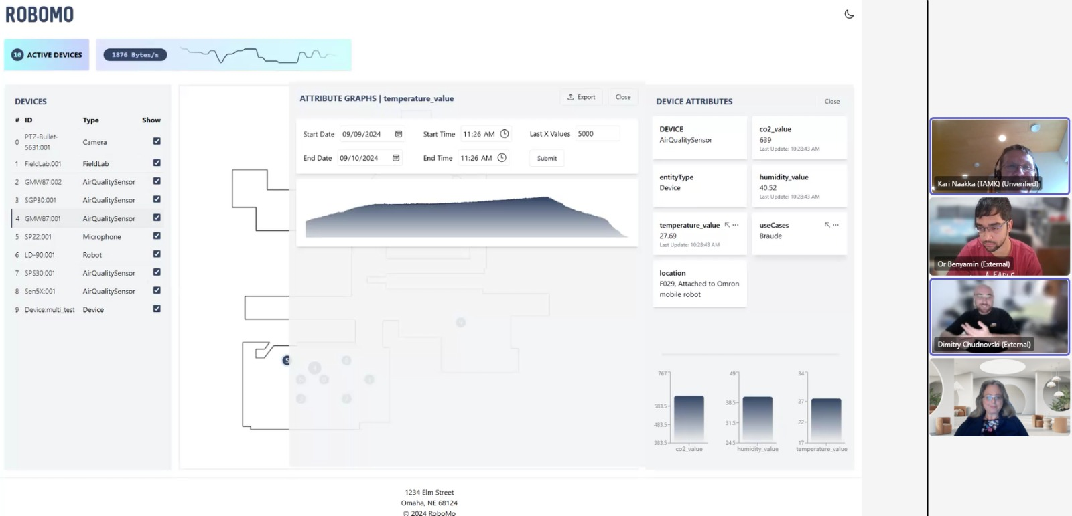
Summary of Meetings
Third Meeting
First look on the book project.
Agreeing on deploying working prototype.
Fourth Meeting
Feedback on Project Book part.
Display current device positions on map.
TAMPERE
University of Applied Sciences
Notes:
In the third meeting the customer had first look on the book project, and we talked about deploying working prototype.
In the forth meeting we got feedback on the book project and talked about displaying current device positions on map.
In the picture you can see a capture from our last meeting when we showed the customer the website progress.

Slide 7



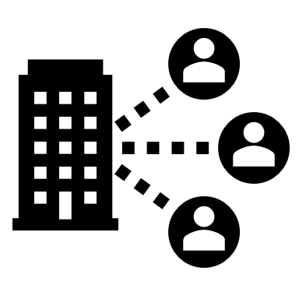

RoboMo System
Comprehensive system which effectively monitor and transmit live data from different robotics.
Efficient way to visualize and analyze sensor data in real-time.
Remote data access and monitoring, allowing users from any location.
TAMPERE
University of Applied Sciences
Notes:
We called the system RoboMo which stands for Robotics Monitoring.
It is a comprehensive system which monitor and transmit live data.
It gives efficient way to visualize and analyze sensor data.
It gives remote data access from any location

Slide 8
Functional Requirements
# | Requirement
1 | The system will allow the administrator to approve new sign-ups
2 | The system will allow users to select devices from a map
3 | The system will allow users to choose which devices are shown on the map
4 | The system will allow users to choose attributes for each device
5 | The system will allow users to add graphs of an attribute to the expanded window
6 | The system will allow users to view the device in 360 degrees
TAMPERE
University of Applied Sciences
Notes:
As for functional requirements we will show six of them:
The system will allow the administrator to approve new sign-ups, the users to select device on map, choose which device is shown on map, choosing attribute of specific device, creating graph with the attribute data and to view device in three sixty.

Slide 9
Non-Functional Requirements
# | Requirement | Type
1 | The site should be easy to use and quick - 85% of users should be able to complete key tasks without assistance | Usability
2 | The site should be easy to maintenance and update - Code modularity should support updates with minimal downtime (<5 minutes) | Maintainability
3 | The site should be mobile friendly (WCAG 2.2, Web Content Accessibility Guidelines 2.2 - 2023) | Adaptability
4 | The system should comply with relevant data protection regulations (e.g., GDPR) | Compliance
5 | The system should support up to 5000 numbers of users connected at the same time without degradation in performance | Scalability
TAMPERE
University of Applied Sciences
Notes:
As for the non-functional requirements:
The site should be easy to use and quick where eighty five percent of users complete key tasks without assistance.
The code support updates with minimal downtime.
It is mobile friendly according to the Web Content Accessibility Guidelines two point two, which address accessibility of web content on desktop, laptop and mobile devices.
It will comply with relevant data protection regulations, the GDPR the General Data Protection Regulation which aims in European Union about collecting data related to people.
It will support up to five thousand users.

Slide 10
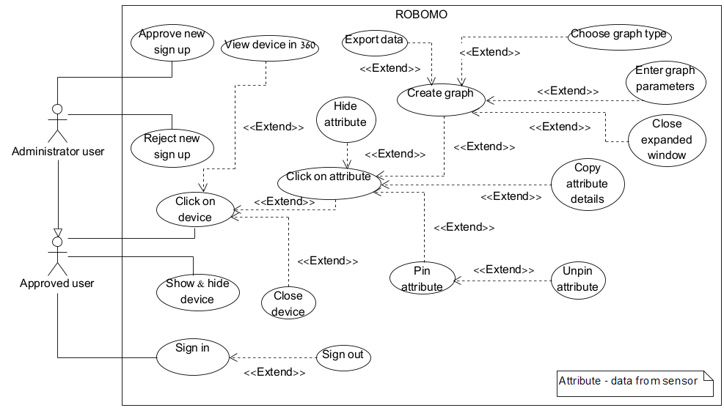
Use Case Diagram
TAMPERE
University of Applied Sciences
Notes:
In the system we have two players, the Approved user and Administrator user. The user can click on device, choose which device will show on map, copy pin or hide attribute of device and can creates graph and exports it to excel file for example.
The administrator user can do all as approved user with addition of approve or reject new sign-ups.
Now Dima will explain about the Activity diagram the system's architecture and ways of evaluation.

Slide 11
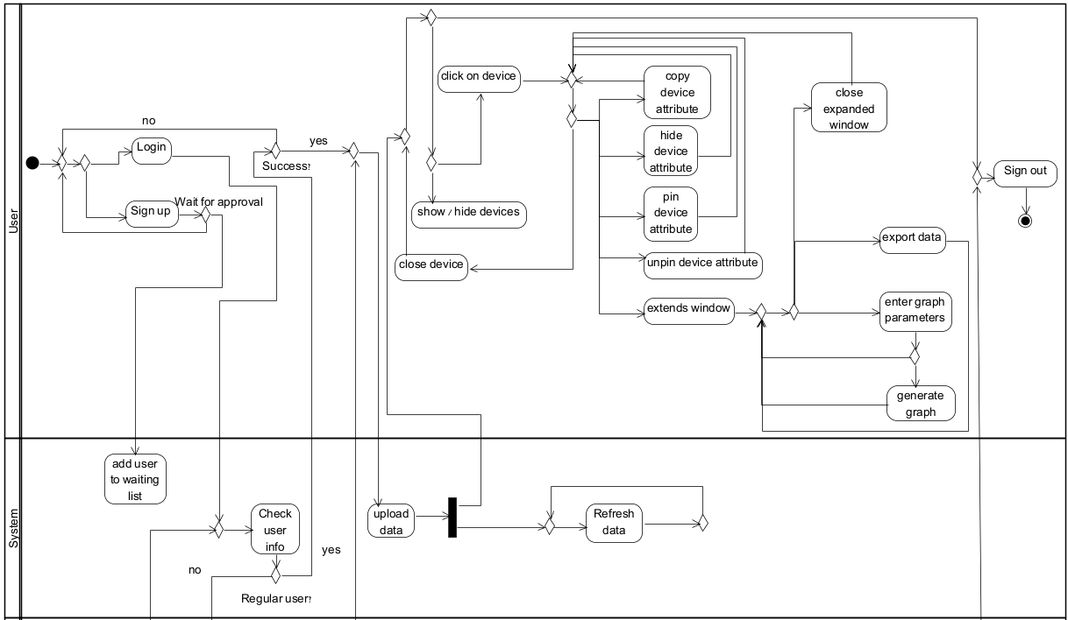

Activity Diagram – User & System
Continue on the next slide...
TAMPERE
University of Applied Sciences
Notes:
Set interval

Slide 12
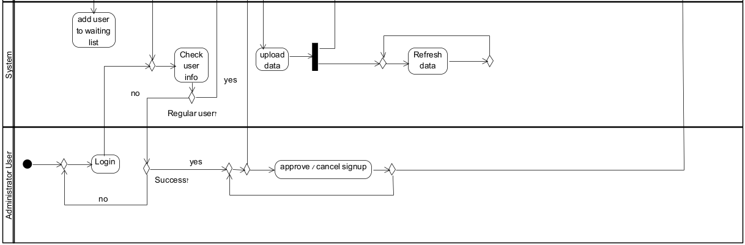
Activity Diagram – Administrator & System
TAMPERE
University of Applied Sciences

Slide 13
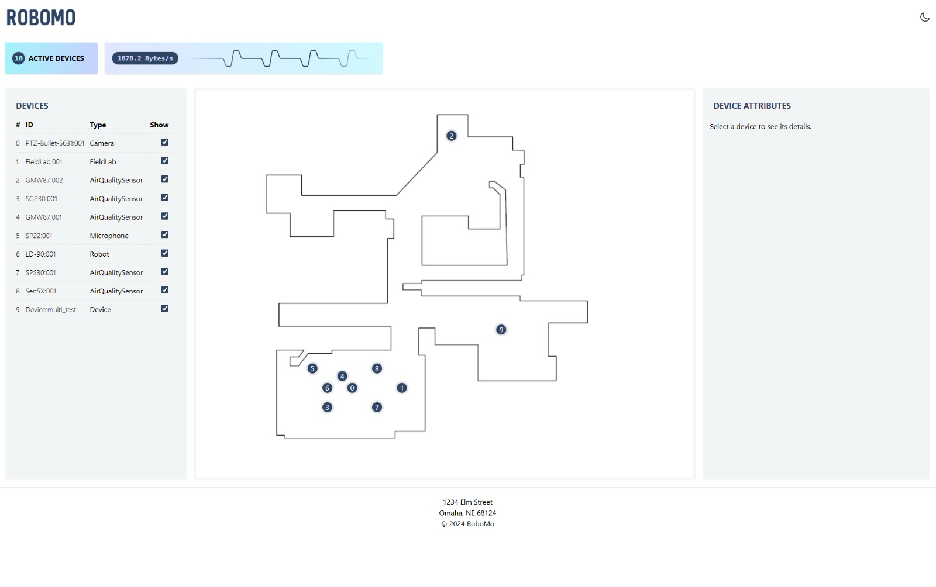
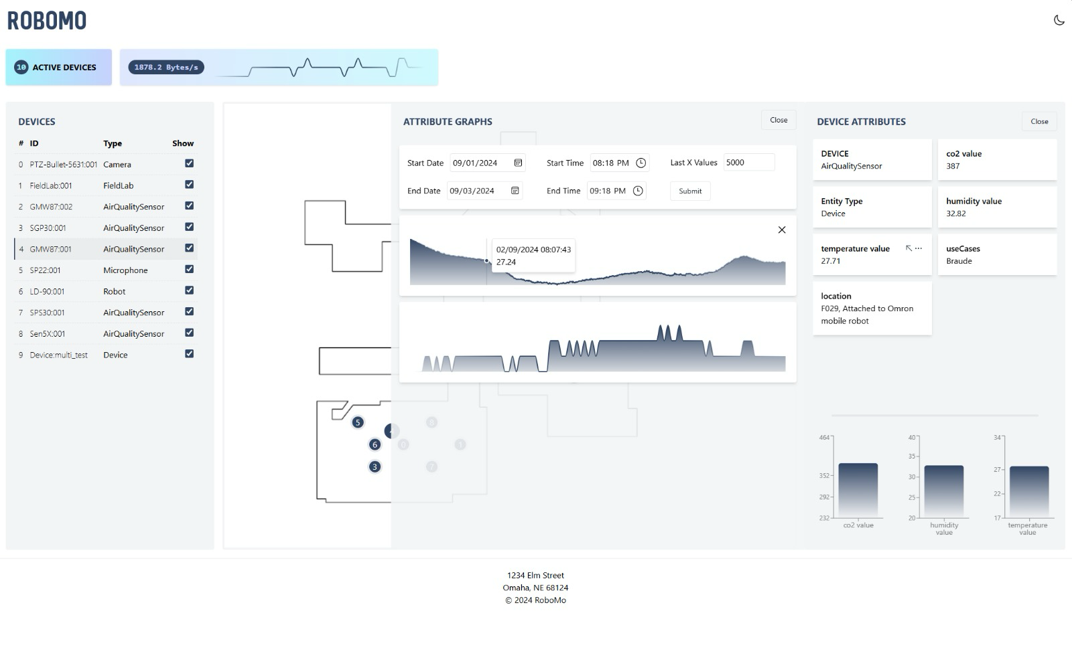

RoboMo Screens*
Home screen
*Live Screens under development
Device Attribute graph screen
TAMPERE
University of Applied Sciences
Notes:
להסביר שמדובר במסכים חיים

Slide 14
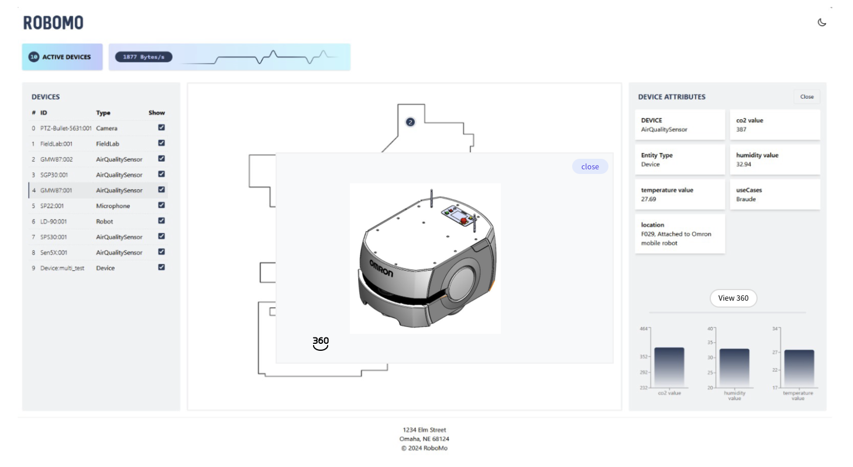
RoboMo Screens*
*Live Screens under development
Device 3D view
TAMPERE
University of Applied Sciences
Notes:
להסביר שמדובר במסכים חיים

Slide 15
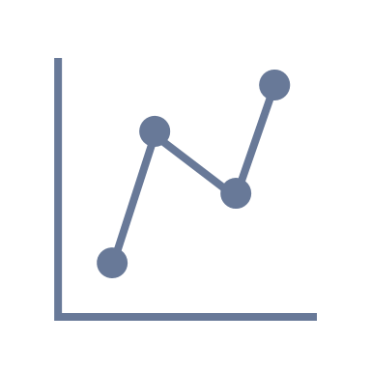

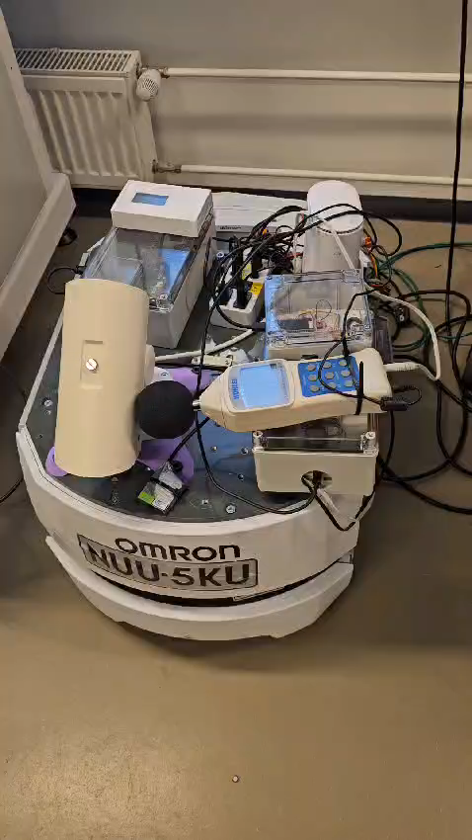




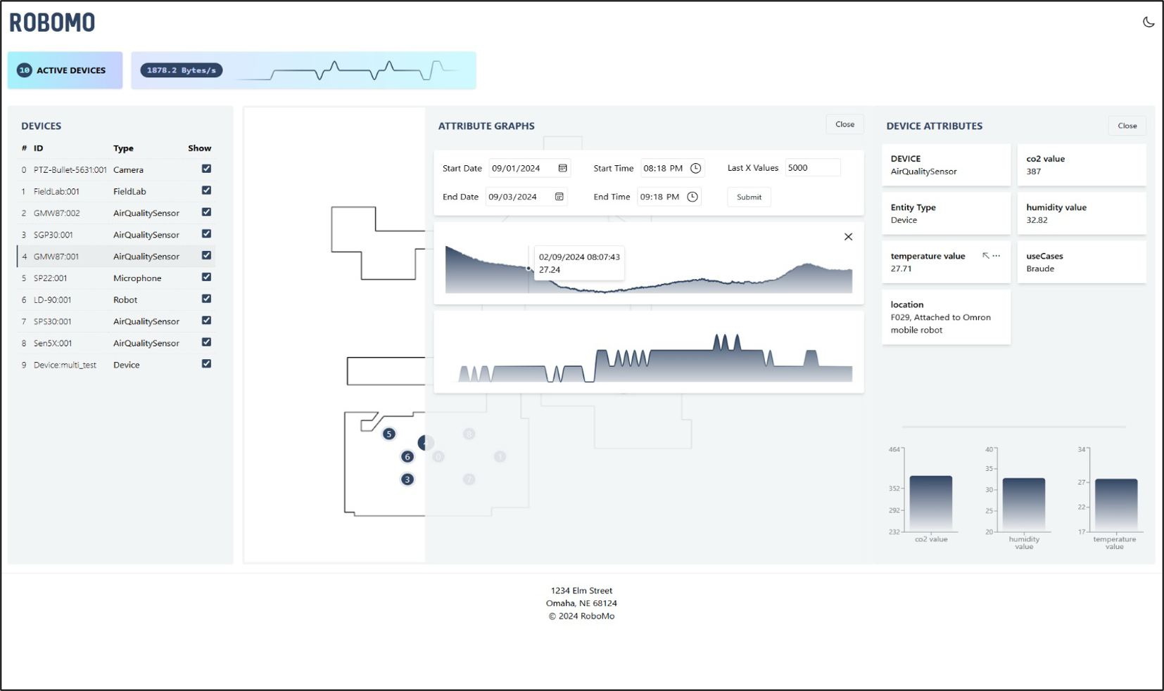


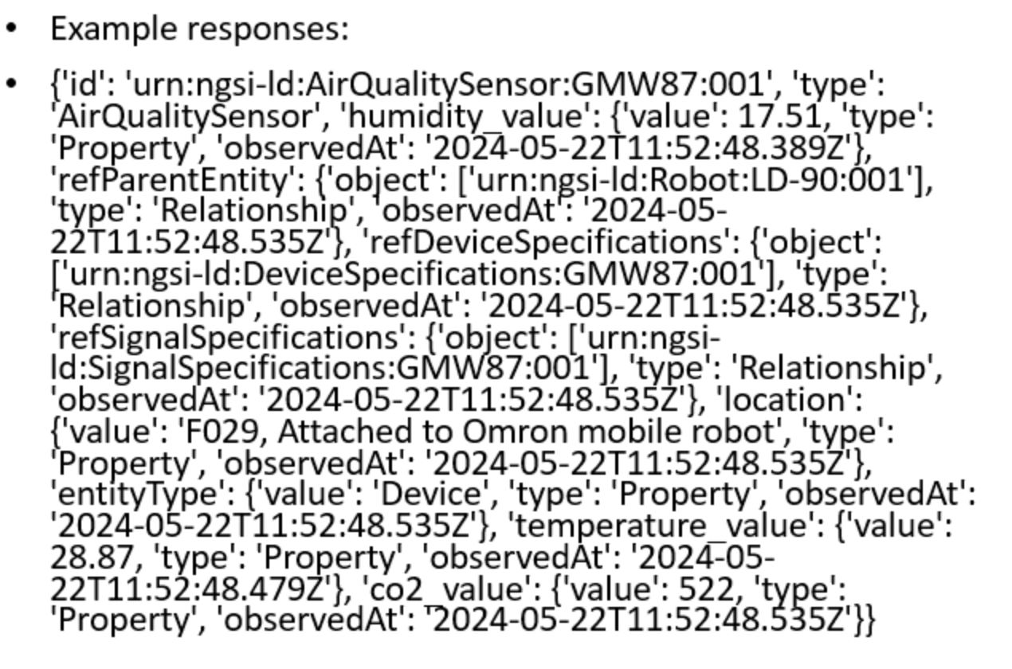

Data Flow
filter
config
request
data
OpenVPN
API ACCESS
WebSocket
Client Side
Server Side
TAMPERE
University of Applied Sciences

Slide 16








Architecture
Client Side
Server Side
Authentication
OpenVPN
Frontend
WebSocket
Backend
TAMK API
React
JavaScript
Node.js
Fiware
Mongo API
HTML 5
Tailwind CSS
WebSocket
TAMPERE
University of Applied Sciences
Notes:
Full-duplex communication refers to a system that allows simultaneous two-way data transmission. In full-duplex mode, both parties (or devices) can send and receive signals at the same time, without waiting for the other to finish.

Slide 17

Evaluation Plan
Conducting the System Usability Scale questionnaire (SUS) - December 24
Open-ended questions for gathering detailed feedback – December 24
Demonstrating the project to lab workers – March 25
Presenting to students who are enrolled in relevant courses – March 25
TAMPERE
University of Applied Sciences
Notes:
The System Usability Scale (SUS) is a simple, ten-item questionnaire used to assess the usability of a product or system. It provides a quick and reliable measure of user satisfaction and is commonly scored on a scale from 0 to 100, where higher scores indicate better usability.
In addition to the SUS, open-ended questions allow participants to provide more in-depth, qualitative feedback. This helps uncover specific issues or suggestions for improvement that may not be captured by the SUS.
You will showcase your project to lab workers to get feedback from individuals who may use the system in a practical, real-world environment. Their insights can offer useful perspectives on functionality and user experience.
By presenting your project to students in relevant courses, you can get feedback from peers who have a theoretical background in the subject. They may offer a different perspective and provide useful critique on technical aspects.

Slide 18

Project Goals
High Data Accuracy
The system will guarantee that all sensor data is transmitted and displayed with high precision.
Scalable Architecture
Supporting increasing numbers of devices without compromising performance.
Demonstration of Robust IoT and Data Monitoring Capabilities
System's ability to monitor and process live data from robotics and sensors.
TAMPERE
University of Applied Sciences
Notes:
High Data Accuracy: The website will guarantee that all sensor data is transmitted and displayed with high precision, providing users with reliable and accurate information.
Scalable Architecture: The system will be designed to support increasing numbers of devices, ensuring scalability without compromising performance.
Demonstration of Robust IoT and Data Monitoring Capabilities: Showcasing the system’s ability to monitor and process live data from robotics and sensors across various environments.

Slide 19




Success Criteria
The website is easy to maintain and update, with clear documentation and well-structured code (e.g., IEEE 828-2012).
The system has a high uptime percentage, consistently maintaining an availability of 95%, ensuring reliable access and minimal downtime for users.
85% of users should be able to complete key tasks without assistance.
TAMPERE
University of Applied Sciences

Slide 20

Testing Case
Filter active devices and display them on the map
Creating graph of specific device attribute
Administrator and User login
Approving new users (Administrator)
TAMPERE
University of Applied Sciences

Slide 21
Thank You For Listening

